Slide 1
SE-210
Software System Requirements
II. Requirements Engineering Processes
Dr. Abdul Aziz
Department of Software Engineering
School of Computing

Slide 2
Objectives
To introduce the notion of processes and process models for requirements engineering
To explain the critical role of people in requirements engineering processes
To explain why process improvements is important and to suggest a process improvement model for requirements engineering
RE-2 <number>

Slide 3
Processes
A process is an organized set of activities which transforms inputs to outputs
Process descriptions encapsulate knowledge and allow it to be reused
Examples of process descriptions
  Instruction manual for a dishwasher
  Cookery book
  Procedures manual for a bank
  Quality manual for software development
RE-2 <number>

Slide 4
Design processes
Processes which involve creativity, interactions between a wide range of different people, engineering judgment and background knowledge and experience
Examples of design processes
  Writing a book
  Organizing a conference
  Designing a processor chip
  Requirements engineering
RE-2 <number>

Slide 5
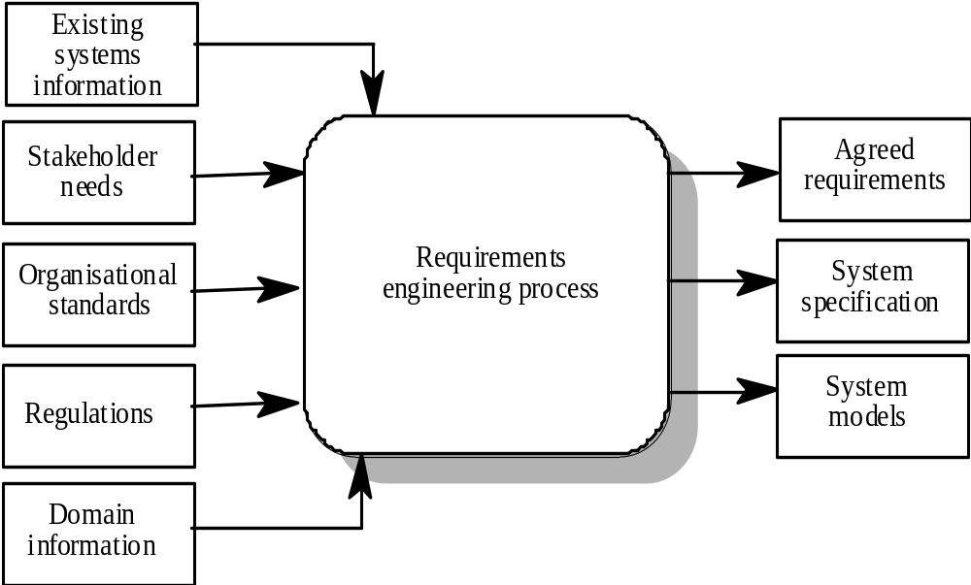
RE process - inputs and outputs
RE-2 <number>

Slide 6
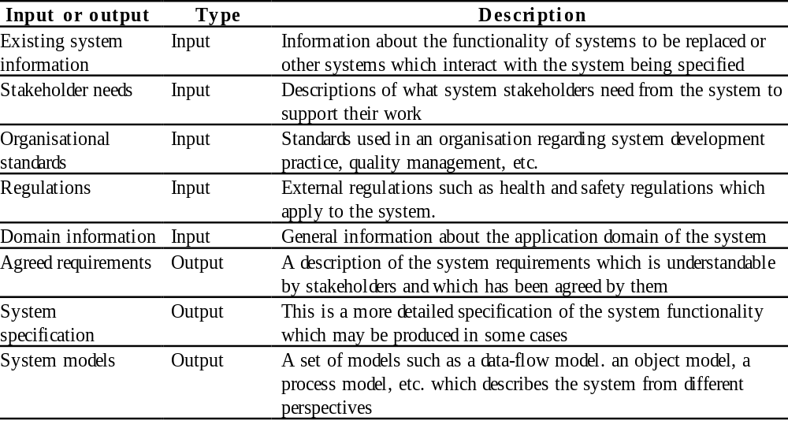
Input/output description
RE-2 <number>

Slide 7
RE process variability
RE processes vary radically from one organization to another
Factors contributing to this variability include
  Technical maturity
  Disciplinary involvement
  Organizational culture
  Application domain
There is therefore no ‘ideal’ requirements engineering process
RE-2 <number>

Slide 8
Process models
A process model is a simplified description of a process presented from a particular perspective
Types of process model include:
  Coarse-grain activity models
  Fine-grain activity models
  Role-action models
  Entity-relation models
RE-2 <number>

Slide 9
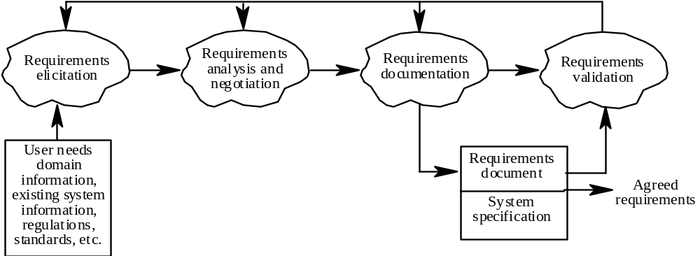
Coarse-grain activity model of RE
RE-2 <number>

Slide 10
RE process activities
Requirements elicitation
  Requirements discovered through consultation with stakeholders
Requirements analysis and negotiation
  Requirements are analyzed and conflicts resolved through negotiation
Requirements documentation
  A requirements document is produced
Requirements validation
  The requirements document is checked for consistency and completeness
RE-2 <number>

Slide 11
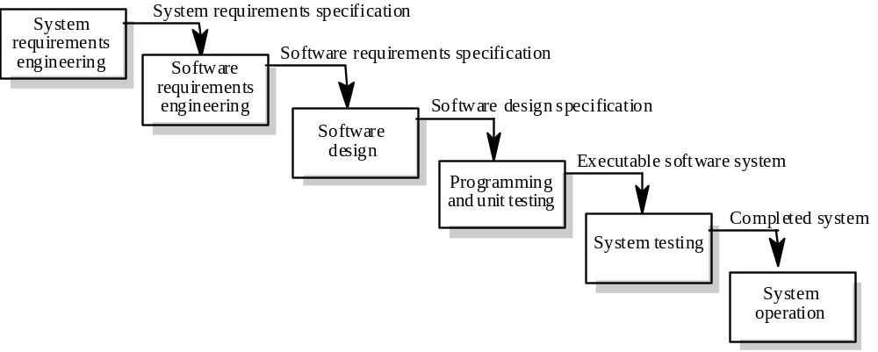
Waterfall model of the software process
RE-2 <number>

Slide 12
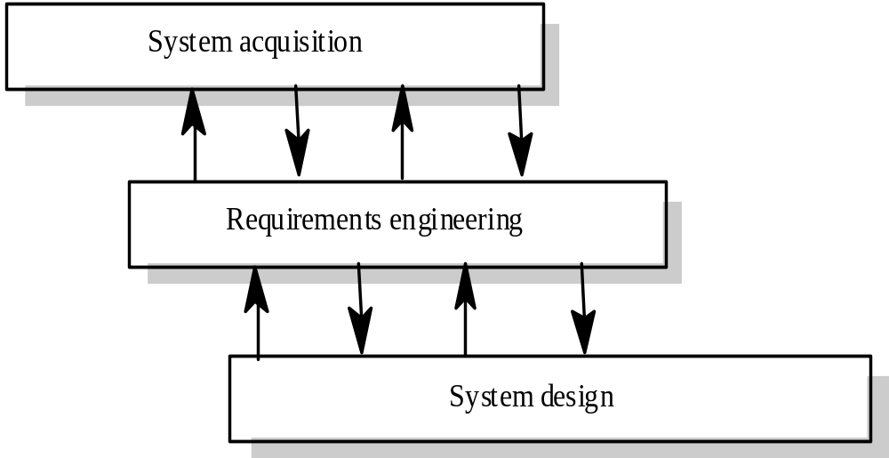
Context of the RE process
RE-2 <number>

Slide 13
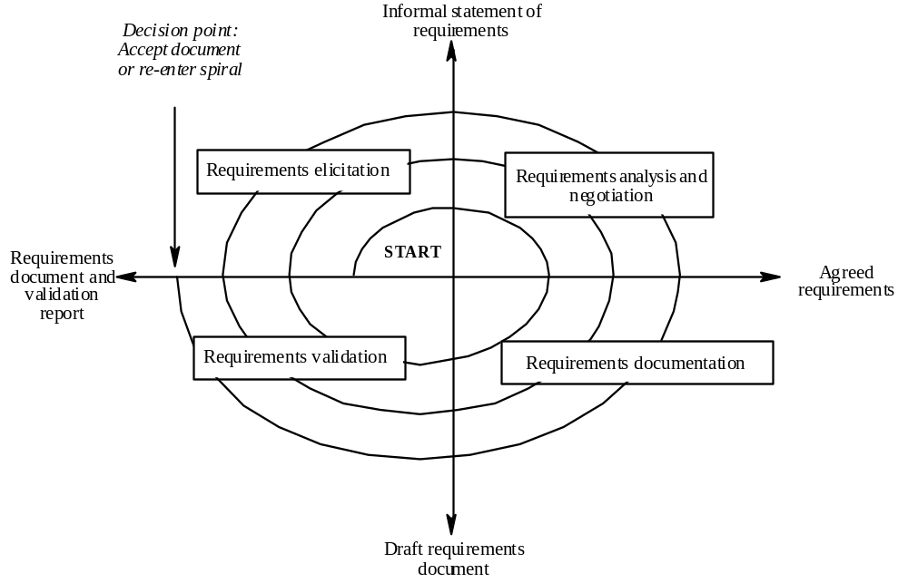
Spiral model of the RE process
RE-2 <number>

Slide 14
Actors in the RE process
Actors in a process are the people involved in the execution of that process
Actors are normally identified by their roles rather than individually
Requirements engineering involves actors who are primarily interested in the problem to be solved (end-users, etc) as well actors interested in the solution (system designers, etc.)
Role-action diagrams document which actors are involved in different activities
RE-2 <number>

Slide 15
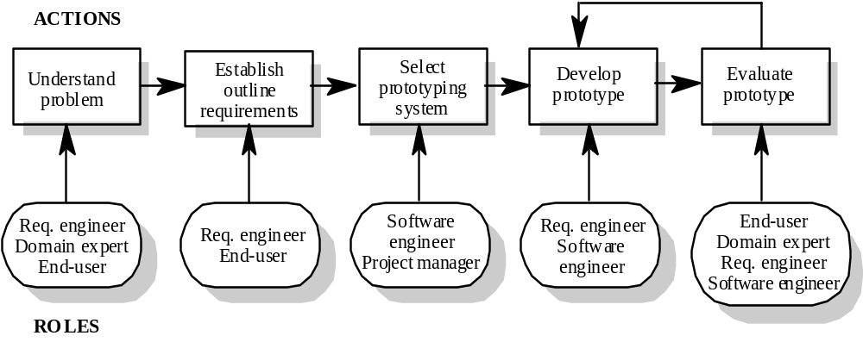
RAD for software prototyping
RE-2 <number>

Slide 16
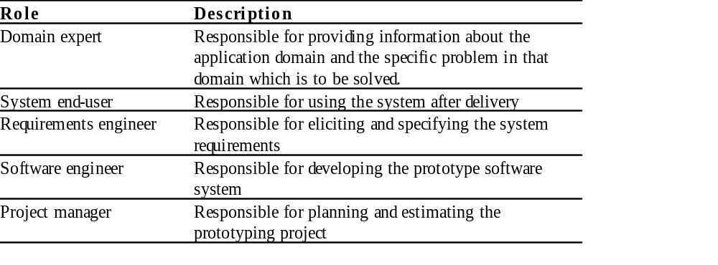
Role descriptions
RE-2 <number>

Slide 17
Human and social factors
Requirements engineering processes are dominated by human, social and organizational factors because they always involve a range of stakeholders from different backgrounds and with different individual and organizational goals.
System stakeholders may come from a range of technical and non-technical background and from different disciplines
RE-2 <number>

Slide 18
Types of stakeholder
Software engineers responsible for system development
System end-users who will use the system after it has been delivered
Managers of system end-users who are responsible for their work
External regulators who check that the system meets its legal requirements
Domain experts who give essential background information about the system application domain
RE-2 <number>

Slide 19
Factors influencing requirements
Personality and status of stakeholders
The personal goals of individuals within an organization
The degree of political influence of stakeholders within an organization
RE-2 <number>

Slide 20
Process support
CASE (Computer-Aided Software Engineering) tools provide automated support for software engineering processes
The most mature CASE tools support well-understood activities such as programming, testing and project management
Support for requirements engineering is still limited because of the informality and the variability of the process
RE-2 <number>

Slide 21
Two types of CASE tools for RE
Modeling and validation tools support the development of system models which can be used to specify the system and the checking of these models for completeness and consistency.
Management tools help manage a database of requirements and support the management of changes to these requirements.
RE-2 <number>

Slide 22
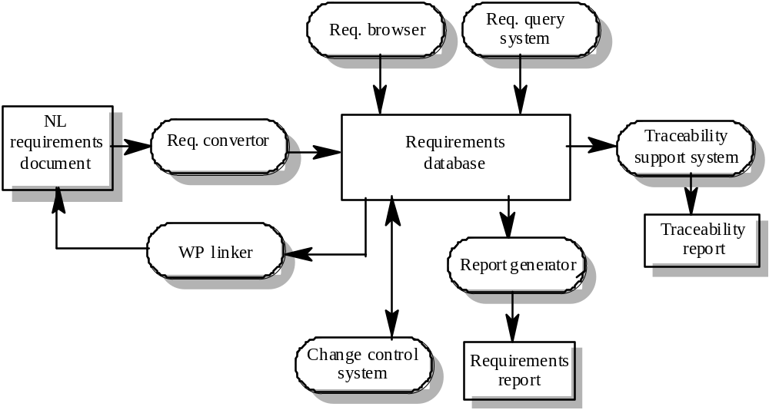
A requirements management system
RE-2 <number>

Slide 23
Requirements management tools
Requirements browser
Requirements query system
Traceability support system
Report generator
Requirements converter and word processor linker
Change control system
RE-2 <number>

Slide 24
Process improvement
Process improvement is concerned with modifying processes in order to meet some improvement objectives
Improvement objectives
  Quality improvement
  Schedule reduction
  Resource reduction
RE-2 <number>

Slide 25
Planning process improvement
What are the problems with current processes?
What are the improvement goals?
How can process improvement be introduced to achieve these goals?
How should process improvements be controlled and managed?
RE-2 <number>

Slide 26
RE process problems
Lack of stakeholder involvement
Business needs not considered
Lack of requirements management
Lack of defined responsibilities
Stakeholder communication problems
Over-long schedules and poor quality requirements documents
RE-2 <number>

Slide 27
Process maturity
Process maturity can be thought of as the extent that an organization has defined its processes, actively controls these processes and provides systematic human and computer-based support for them.
The SEI’s Capability Maturity Model is a framework for assessing software process maturity in development organizations
RE-2 <number>

Slide 28
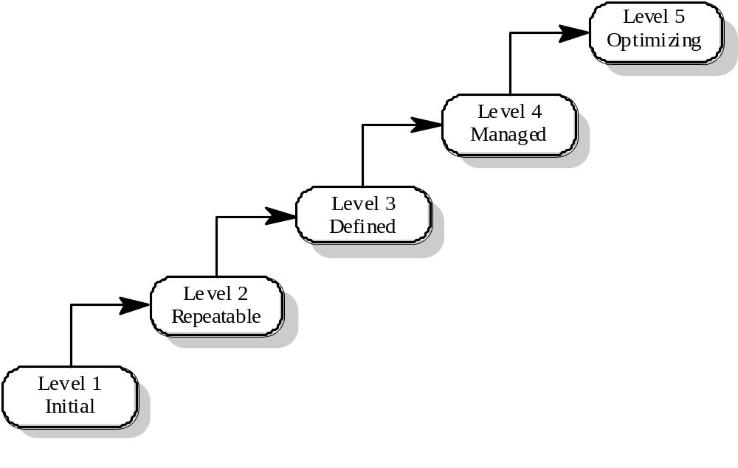
Capability maturity model
RE-2 <number>

Slide 29
Maturity levels
Initial level
  Organizations have an undisciplined process and it is left to individuals how to manage the process and which development techniques to use.
Repeatable level
  Organizations have basic cost and schedule management procedures in place. They are likely to be able to make consistent budget and schedule predictions for projects in the same application area.
Defined level
  The software process for both management and engineering activities is documented, standardized and integrated into a standard software process for the organization.
RE-2 <number>

Slide 30
Maturity levels
Managed level
  Detailed measurements of both process and product quality are collected and used to control the process.
Optimizing level
  The organization has a continuous process improvement strategy, based on objective measurements, in place.
RE-2 <number>

Slide 31
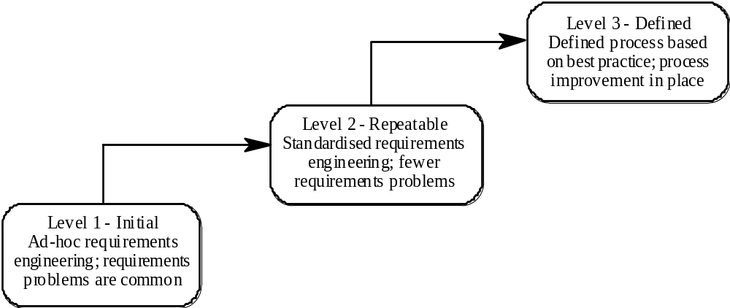
RE process maturity model
RE-2 <number>

Slide 32
RE process maturity levels
Initial level
  No defined RE process. Suffer from requirements problems such as requirements volatility, unsatisfied stakeholders and high rework costs. Dependent on individual skills and experience.
Repeatable level
  Defined standards for requirements documents and policies and procedures for requirements management.
Defined level
  Defined RE process based on good practices and techniques. Active process improvement process in place.
RE-2 <number>

Slide 33
Good practice for RE process improvement
RE processes can be improved by the systematic introduction of good requirements engineering practice
Each improvement cycle identifies good practice guidelines and works to introduce them in an organization
RE-2 <number>

Slide 34
Examples of good practice guidelines
Define a standard document structure
Uniquely identify each requirement
Define policies for requirements management
Use checklists for requirements analysis
Use scenarios to elicit requirements
Specify requirements quantitatively
Use prototyping to animate requirements
Reuse requirements
RE-2 <number>

Slide 35
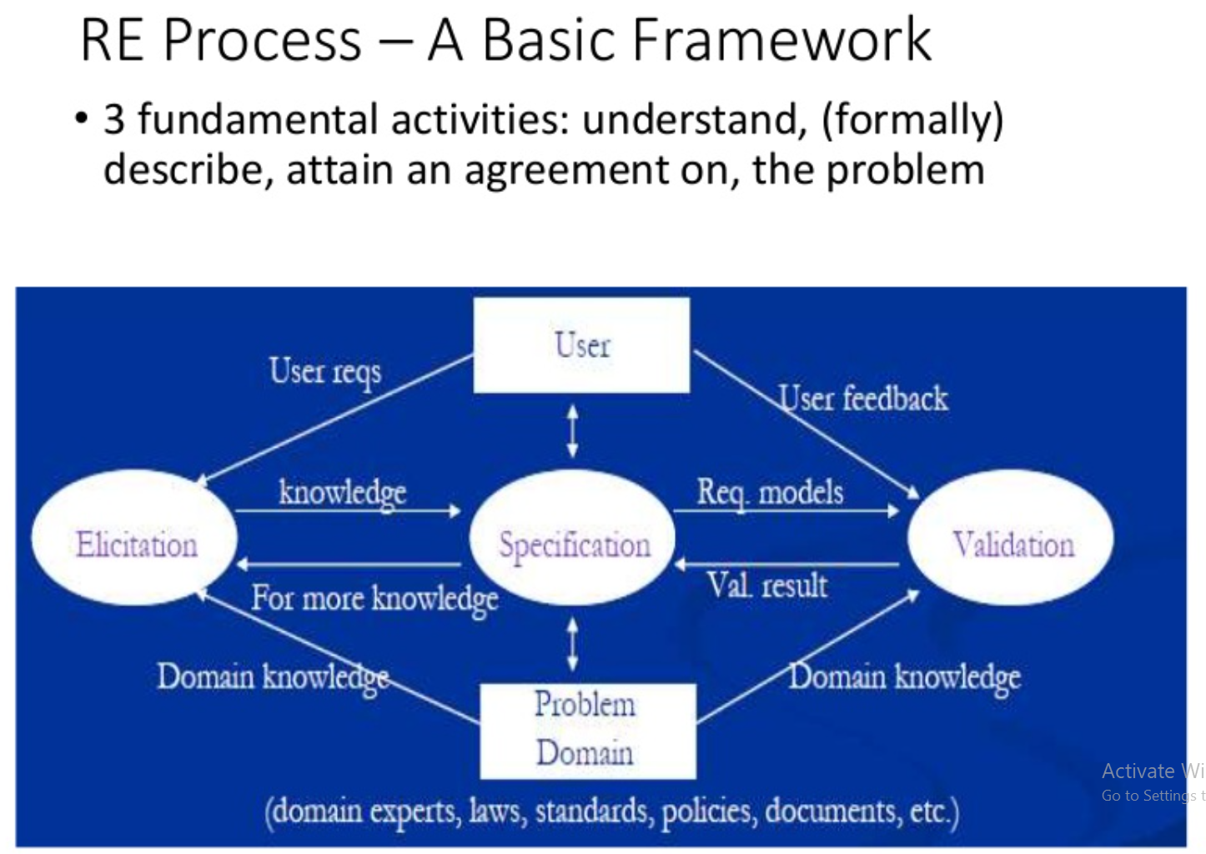
RE-2 <number>

Slide 36
Assignment 2
Explain why there is a great deal of variability in the requirements engineering processes used in different organizations?
Explain why both coarse-grain and fine-grain activity models of a process should be produced in an organization.
Explain why waterfall model of the software process is not an accurate reflection of the detailed software process in most organizations. Why is spiral model more realistic?
Why is it important to understand the roles of people involved in requirements engineering processes?
What factors are likely to be particularly significant when considering requirements engineering process improvement?

